Slide 1

Spring
6
Word Relationships and Statistics
Stuy Prep
Practice 26S6
Notes:
Slide designed by Benjamin Xie. Logo designed by Madeleine Villamil.

Slide 2
metaphor sarcastic parallelism
Spring
6
English Language Arts
Word Relationships
hyperbole cynical repetition
Notes:
Slide designed by Benjamin Xie. Logo designed by Madeleine Villamil.

Slide 3
Question 1
The committee’s decision was hardly surprising. After all, they had ignored expert recommendations for months and consistently chosen the most convenient—rather than the most effective—solutions. Still, it’s impressive how they continue to present their missteps as strategic brilliance.
1. What is the author’s tone toward the committee’s actions?
A) Respectful B) Frustrated C) Sarcastic D) Objective
hyperbole cynical repetition
Notes:
Slide designed by Amy Shrestha.

Slide 4
Question 1
The committee’s decision was hardly surprising. After all, they had ignored expert recommendations for months and consistently chosen the most convenient—rather than the most effective—solutions. Still, it’s impressive how they continue to present their missteps as strategic brilliance.
1. What is the author’s tone toward the committee’s actions?
A) Respectful B) Frustrated C) Sarcastic D) Objective
hyperbole cynical repetition
Notes:
Slide designed by Amy Shrestha.

Slide 5
Question 2
Though many hail the smartphone era as a triumph of innovation, the truth is more complicated. We are more connected than ever, yes, but also more distracted, isolated, and addicted to digital validation. This is progress with a price—and we’re just beginning to tally the cost.
2. What best describes the author’s tone?
A) Reflective B) Disappointed C) Hopeful D) Dismissive
hyperbole cynical repetition
Notes:
Slide designed by Amy Shrestha.

Slide 6
Question 2
Though many hail the smartphone era as a triumph of innovation, the truth is more complicated. We are more connected than ever, yes, but also more distracted, isolated, and addicted to digital validation. This is progress with a price—and we’re just beginning to tally the cost.
2. What best describes the author’s tone?
A) Reflective B) Disappointed C) Hopeful D) Dismissive
hyperbole cynical repetition
Notes:
Slide designed by Amy Shrestha.

Slide 7
Question 3
Inventors of the so-called “revolutionary” device claimed it would change everything. In reality, it performed few functions well and often malfunctioned during crucial moments. Its glowing reviews, it turns out, were less a result of merit and more a consequence of clever marketing.
3. What is the author’s tone toward the device?
A) Grateful B) Amused C) Enthusiastic D) Skeptical
hyperbole cynical repetition
Notes:
Slide designed by Amy Shrestha.

Slide 8
Question 3
Inventors of the so-called “revolutionary” device claimed it would change everything. In reality, it performed few functions well and often malfunctioned during crucial moments. Its glowing reviews, it turns out, were less a result of merit and more a consequence of clever marketing.
3. What is the author’s tone toward the device?
A) Grateful B) Amused C) Enthusiastic D) Skeptical
hyperbole cynical repetition
Notes:
Slide designed by Amy Shrestha.

Slide 9
Question 4
With every passing year, more forests vanish, more species disappear, and more promises from global leaders dissolve into empty pledges. Perhaps the real endangered species is accountability.
4. What best describes the author’s tone?
A) Angry B) Cynical C) Informative D) Sympathetic
hyperbole cynical repetition
Notes:
Slide designed by Amy Shrestha.

Slide 10
Question 4
With every passing year, more forests vanish, more species disappear, and more promises from global leaders dissolve into empty pledges. Perhaps the real endangered species is accountability.
4. What best describes the author’s tone?
A) Angry B) Cynical C) Informative D) Sympathetic
hyperbole cynical repetition
Notes:
Slide designed by Amy Shrestha.

Slide 11
Question 5
The so-called “innovative” software was riddled with bugs from launch day. Users found it nearly impossible to navigate, and many gave up within hours. Yet somehow, the developers continued to praise its “intuitive design.”
5. What is the author’s tone in the passage?
A) Hopeful B) Sarcastic C) Neutral D) Objective
hyperbole cynical repetition
Notes:
Slide designed by Amy Shrestha.

Slide 12
Question 5
The so-called “innovative” software was riddled with bugs from launch day. Users found it nearly impossible to navigate, and many gave up within hours. Yet somehow, the developers continued to praise its “intuitive design.”
5. What is the author’s tone in the passage?
A) Hopeful B) Sarcastic C) Neutral D) Objective
hyperbole cynical repetition
Notes:
Slide designed by Amy Shrestha.

Slide 13
Question 6
Despite the artist’s growing popularity online, his early work remains overlooked. Raw, powerful, and unapologetically experimental, these pieces challenge viewers far more than his recent, polished creations.
6. What is the author’s tone toward the artist’s early work?
A) Critical B) Admiring C) Indifferent D) Neutral
hyperbole cynical repetition
Notes:
Slide designed by Amy Shrestha.

Slide 14
Question 6
Despite the artist’s growing popularity online, his early work remains overlooked. Raw, powerful, and unapologetically experimental, these pieces challenge viewers far more than his recent, polished creations.
6. What is the author’s tone toward the artist’s early work?
A) Critical B) Admiring C) Indifferent D) Neutral
hyperbole cynical repetition
Notes:
Slide designed by Amy Shrestha.

Slide 15
Question 7
Each new update claims to fix previous issues, but somehow creates more problems. If progress means spending twice the time for half the results, then this is a true technological marvel indeed.
7. What is the author’s tone?
A) Cynical B) Curious C) Grateful D) Reflective
hyperbole cynical repetition
Notes:
Slide designed by Amy Shrestha.

Slide 16
Question 7
Each new update claims to fix previous issues, but somehow creates more problems. If progress means spending twice the time for half the results, then this is a true technological marvel indeed.
7. What is the author’s tone?
A) Cynical B) Curious C) Grateful D) Reflective
hyperbole cynical repetition
Notes:
Slide designed by Amy Shrestha.

Slide 17
Question 7
While the idea behind the campaign was admirable, its execution lacked depth and planning. Unfortunately, well-meaning intentions don’t always translate into meaningful results.
7. What is the author’s tone?
A) Dismissive B) Sympathetic C) Disappointed D) Playful
hyperbole cynical repetition
Notes:
Slide designed by Amy Shrestha.

Slide 18
Question 7
While the idea behind the campaign was admirable, its execution lacked depth and planning. Unfortunately, well-meaning intentions don’t always translate into meaningful results.
7. What is the author’s tone?
A) Dismissive B) Sympathetic C) Disappointed D) Playful
hyperbole cynical repetition
Notes:
Slide designed by Amy Shrestha.

Slide 19
Question 8
8. Choose the word with a positive connotation:
A) Bossy
B) Assertive
C) Pushy
D) Controlling
hyperbole cynical repetition
Notes:
Slide designed by Amy Shrestha.

Slide 20
Question 8
8. Choose the word with a positive connotation:
A) Bossy
B) Assertive
C) Pushy
D) Controlling
hyperbole cynical repetition
Notes:
Slide designed by Amy Shrestha.

Slide 21
Question 9
Mrs. Alvarez was known throughout the neighborhood for her careful spending habits. While others wasted money on unnecessary items, she always searched for sales and reused what she already had. She brought lunch from home instead of buying it and repaired old clothes rather than replacing them. Some people admired her practical mindset, while others quietly criticized her for being overly cautious with her money. Still, her frugal lifestyle allowed her to save enough to help her family when they needed it most.
9. What is the connotation of the word “frugal” in the passage?
A) Careful and practical with money B) Poor and struggling
C) Selfish and greedy D) Wasteful and carefless
hyperbole cynical repetition
Notes:
Slide designed by Amy Shrestha.

Slide 22
Question 9
Mrs. Alvarez was known throughout the neighborhood for her careful spending habits. While others wasted money on unnecessary items, she always searched for sales and reused what she already had. She brought lunch from home instead of buying it and repaired old clothes rather than replacing them. Some people admired her practical mindset, while others quietly criticized her for being overly cautious with her money. Still, her frugal lifestyle allowed her to save enough to help her family when they needed it most.
9. What is the connotation of the word “frugal” in the passage?
A) Careful and practical with money B) Poor and struggling
C) Selfish and greedy D) Wasteful and carefless
hyperbole cynical repetition
Notes:
Slide designed by Amy Shrestha.

Slide 23
Question 10
During the group activity, students shouted over one another, papers flew off desks, and no one seemed to agree on anything. By the time the teacher returned, the classroom had turned into a zoo.
10. What does the line “the classroom had turned into a zoo” suggest?
A) Animals entered the classroom
B) The classroom became loud and chaotic C) The classroom was cleaned quickly D) The students were studying animals
hyperbole cynical repetition
Notes:
Slide designed by Amy Shrestha.

Slide 24
Question 10
During the group activity, students shouted over one another, papers flew off desks, and no one seemed to agree on anything. By the time the teacher returned, the classroom had turned into a zoo.
10. What does the line “the classroom had turned into a zoo” suggest?
A) Animals entered the classroom
B) The classroom became loud and chaotic C) The classroom was cleaned quickly D) The students were studying animals
hyperbole cynical repetition
Notes:
Slide designed by Amy Shrestha.

Slide 25
Question 11
The old house stood at the end of the street, its windows cracked and its paint peeling. At night, the wind seemed to whisper through the halls, as if the house itself were trying to tell a story.
11. What figure of speech is primarily used?
A) Simile B) Metaphor C) Personification D) Hyperbole
hyperbole cynical repetition
Notes:
Slide designed by Amy Shrestha.

Slide 26
Question 11
The old house stood at the end of the street, its windows cracked and its paint peeling. At night, the wind seemed to whisper through the halls, as if the house itself were trying to tell a story.
11. What figure of speech is primarily used?
A) Simile B) Metaphor C) Personification D) Hyperbole
hyperbole cynical repetition
Notes:
Slide designed by Amy Shrestha.

Slide 27
Question 12
As the argument continued, Maya’s patience began to slip away. By the end of the conversation, her calm demeanor had melted like ice under the hot sun.
12. What does the passage suggest about Maya?
A) She became physically warm
B) She went outside
C) She lost her patience completely
D) She started to relax
hyperbole cynical repetition
Notes:
Slide designed by Amy Shrestha.

Slide 28
Question 12
As the argument continued, Maya’s patience began to slip away. By the end of the conversation, her calm demeanor had melted like ice under the hot sun.
12. What does the passage suggest about Maya?
A) She became physically warm
B) She went outside
C) She lost her patience completely
D) She started to relax
hyperbole cynical repetition
Notes:
Slide designed by Amy Shrestha.

Slide 29
Question 13
Although Priya had carefully prepared her response, the unexpected question caused her confidence to falter. In that moment, her thoughts seemed to dissolve, leaving her grasping for even the simplest words.
13. What does “her thoughts seemed to dissolve” imply?
A) Her ideas became unclear or inaccessible
B) She chose not to answer
C) Her response improved over time
D) She ignored the question entirely
hyperbole cynical repetition
Notes:
Slide designed by Amy Shrestha.

Slide 30
Question 13
Although Priya had carefully prepared her response, the unexpected question caused her confidence to falter. In that moment, her thoughts seemed to dissolve, leaving her grasping for even the simplest words.
13. What does “her thoughts seemed to dissolve” imply?
A) Her ideas became unclear or inaccessible
B) She chose not to answer
C) Her response improved over time
D) She ignored the question entirely
hyperbole cynical repetition
Notes:
Slide designed by Amy Shrestha.

Slide 31
Question 14
As the principal announced the results, a heavy silence settled over the auditorium. The disappointment in the room spread quickly, casting a shadow over even those who had not expected to win.
14. What does “casting a shadow” most nearly suggest?
A) The lights in the room dimmed
B) The audience became quiet
C) The announcement lasted a long time
D) The mood became somber and discouraging
hyperbole cynical repetition
Notes:
Slide designed by Amy Shrestha.

Slide 32
Question 14
As the principal announced the results, a heavy silence settled over the auditorium. The disappointment in the room spread quickly, casting a shadow over even those who had not expected to win.
14. What does “casting a shadow” most nearly suggest?
A) The lights in the room dimmed
B) The audience became quiet
C) The announcement lasted a long time
D) The mood became somber and discouraging
hyperbole cynical repetition
Notes:
Slide designed by Amy Shrestha.

Slide 33
mean mode average range
Spring
6
Mathematics
Statistics
interquartile range standard deviation
Notes:
Slide designed by Benjamin Xie and Amy Shrestha.

Slide 34
Questions 1–6 are based on the following information.
Victoria wants to study the heights of students at Park Hill Junior High School.
interquartile range standard deviation
Notes:
Standard approximation: NY-6.SP.1
Slide designed by Benjamin Xie. Logo by Madeleine Villamil.

Slide 35
Question 1
She asks the question, “How tall are the students in my school?”. Explain why this is a statistical question.
Acceptable answers include that it anticipates variability in the students' heights.
interquartile range standard deviation
Notes:
Standard approximation: NY-6.SP.1
Slide designed by Benjamin Xie. Logo by Madeleine Villamil.

Slide 36
Question 2
It would take too long for Victoria to get the heights of all 900 students in her school, so she decides to get a sample of 60 students instead. Out of the four options below, what would be the best way to get a representative sample?
(Answers are on the next slide.)
interquartile range standard deviation
Notes:
Standard approximation: NY-6.SP.1
Slide designed by Benjamin Xie. Logo by Madeleine Villamil.

Slide 37
Question 2
Send an online form in a Discord server with half of the school's students.
Before school, arrive early. Then ask every tenth student who enters at the main entrance.
Ask Ms. Browning, a band elective teacher, to survey all of her students.
Set up a tent outside the school's main entrance. Students can choose to go to the tent to answer the question.
Send an online form in a Discord server with half of the school's students.
Before school, arrive early. Then ask every tenth student who enters at the main entrance.
Ask Ms. Browning, a band elective teacher, to survey all of her students.
Set up a tent outside the school's main entrance. Students can choose to go to the tent to answer the question.
interquartile range standard deviation
Notes:
Standard approximation: NY-6.SP.1
Slide designed by Benjamin Xie. Logo by Madeleine Villamil.

Slide 38
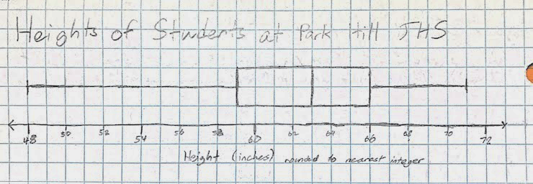
Question 3
Victoria collected the heights of 90 students and created the box plot below. What is the range of the sample?
Acceptable answers include 23 inches.
interquartile range standard deviation
Notes:
Standard approximation: NY-6.SP.1
Slide designed by Benjamin Xie. Logo by Madeleine Villamil.

Slide 39
Question 4
What is the median?
48 inches
59 inches
63 inches
66 inches
71 inches
None of the above
48 inches
59 inches
63 inches
66 inches
71 inches
None of the above
interquartile range standard deviation
Notes:
Standard approximation: NY-6.SP.1
Slide designed by Benjamin Xie. Logo by Madeleine Villamil.

Slide 40
Question 5
Calculate the interquartile range of the data.
Acceptable answers include 7 inches.
interquartile range standard deviation
Notes:
Standard approximation: NY-6.SP.1
Slide designed by Benjamin Xie. Logo by Madeleine Villamil.

Slide 41
Question 6
Determine if 48 inches and 71 inches are outliers.
48 and 71 are outliers
48 only
71 only
Neither are outliers
48 and 71 are outliers
48 only
71 only
Neither are outliers
interquartile range standard deviation
Notes:
Standard approximation: NY-6.SP.1
Slide designed by Benjamin Xie. Logo by Madeleine Villamil.

Slide 42
Question 7
Students' Weekly Study Hours by Subject
How many total hours did Dana study during the week?
A) 14
B) 15
C) 16
D) 17
Student | Math | ELA | Science | History
Alex | 5 | 4 | 3 | 2
Brian | 6 | 5 | 4 | 1
Carlos | 3 | 6 | 2 | 2
Dana | 4 | 5 | 5 | 3
interquartile range standard deviation
Notes:
Standard approximation: NY-6.SP.1
Slide designed by Benjamin Xie. Logo by Madeleine Villamil.

Slide 43
Question 7
Students' Weekly Study Hours by Subject
How many total hours did Dana study during the week?
A) 14
B) 15
C) 16
D) 17
Student | Math | ELA | Science | History
Alex | 5 | 4 | 3 | 2
Brian | 6 | 5 | 4 | 1
Carlos | 3 | 6 | 2 | 2
Dana | 4 | 5 | 5 | 3
interquartile range standard deviation
Notes:
Standard approximation: NY-6.SP.1
Slide designed by Benjamin Xie. Logo by Madeleine Villamil.

Slide 44
Question 8
Students' Weekly Study Hours by Subject
Which subject had the highest total study time across all students?
A) Math
B) ELA
C) Science
D) History
Student | Math | ELA | Science | History
Alex | 5 | 4 | 3 | 2
Brian | 6 | 5 | 4 | 1
Carlos | 3 | 6 | 2 | 2
Dana | 4 | 5 | 5 | 3
interquartile range standard deviation
Notes:
Standard approximation: NY-6.SP.1
Slide designed by Benjamin Xie. Logo by Madeleine Villamil.

Slide 45
Question 8
Students' Weekly Study Hours by Subject
Which subject had the highest total study time across all students?
A) Math
B) ELA
C) Science
D) History
Student | Math | ELA | Science | History
Alex | 5 | 4 | 3 | 2
Brian | 6 | 5 | 4 | 1
Carlos | 3 | 6 | 2 | 2
Dana | 4 | 5 | 5 | 3
interquartile range standard deviation
Notes:
Standard approximation: NY-6.SP.1
Slide designed by Benjamin Xie. Logo by Madeleine Villamil.

Slide 46
Question 9
Students' Weekly Study Hours by Subject
What is the average number of hours Brian spent studying per subject?
A) 4
B) 4.25
C) 4.5
D) 5
Student | Math | ELA | Science | History
Alex | 5 | 4 | 3 | 2
Brian | 6 | 5 | 4 | 1
Carlos | 3 | 6 | 2 | 2
Dana | 4 | 5 | 5 | 3
interquartile range standard deviation
Notes:
Standard approximation: NY-6.SP.1
Slide designed by Benjamin Xie. Logo by Madeleine Villamil.

Slide 47
Question 9
Students' Weekly Study Hours by Subject
What is the average number of hours Brian spent studying per subject?
A) 4
B) 4.25
C) 4.5
D) 5
Student | Math | ELA | Science | History
Alex | 5 | 4 | 3 | 2
Brian | 6 | 5 | 4 | 1
Carlos | 3 | 6 | 2 | 2
Dana | 4 | 5 | 5 | 3
interquartile range standard deviation
Notes:
Standard approximation: NY-6.SP.1
Slide designed by Benjamin Xie. Logo by Madeleine Villamil.

Slide 48
Question 10
If each hour of Math study improves a student's score by 2 points, and each hour of Science by 1.5 points, which student would earn the highest combined point increase from Math + Science?
Students' Weekly Study Hours by Subject
Student | Math | ELA | Science | History
Alex | 5 | 4 | 3 | 2
Brian | 6 | 5 | 4 | 1
Carlos | 3 | 6 | 2 | 2
Dana | 4 | 5 | 5 | 3
interquartile range standard deviation
Notes:
Standard approximation: NY-6.SP.1
Slide designed by Benjamin Xie. Logo by Madeleine Villamil.

Slide 49
Question 10
Acceptable answers include Brian.
Students' Weekly Study Hours by Subject
Student | Math | ELA | Science | History
Alex | 5 | 4 | 3 | 2
Brian | 6 | 5 | 4 | 1
Carlos | 3 | 6 | 2 | 2
Dana | 4 | 5 | 5 | 3
interquartile range standard deviation
Notes:
Standard approximation: NY-6.SP.1
Slide designed by Benjamin Xie. Logo by Madeleine Villamil.

Slide 50
Question 11
If ELA hours are doubled for Carlos and Math hours are reduced by 1 for Dana, who then has the highest total weekly study hours?
Students' Weekly Study Hours by Subject
Student | Math | ELA | Science | History
Alex | 5 | 4 | 3 | 2
Brian | 6 | 5 | 4 | 1
Carlos | 3 | 6 | 2 | 2
Dana | 4 | 5 | 5 | 3
Acceptable answers include Carlos.
interquartile range standard deviation
Notes:
Standard approximation: NY-6.SP.1
Slide designed by Benjamin Xie. Logo by Madeleine Villamil.

Slide 51
Questions 12–19 are based on the following information.
Your boss, Jericho, records how many of his 10 employees show up to work at his restaurant, Jericho's Burgers, each day (at any time) for 20 days, in order to determine the number of employees available on a typical day.
interquartile range standard deviation
Notes:
Standard approximation: NY-6.SP.1
Slide designed by Benjamin Xie. Logo by Madeleine Villamil.

Slide 52
Question 12
Identify what the arithmetic mean, median, mean absolute deviation (MAD), and interquartile range (IQR) measure in any set of data.
(Acceptable answers are shown on the next slide.)
interquartile range standard deviation
Notes:
Standard approximation: NY-6.SP.1
Slide designed by Benjamin Xie. Logo by Madeleine Villamil.

Slide 53
Question 12
The arithmetic mean is a measure of center that is calculated by summing all of the data points and dividing by the sample size. The median is also a measure of center that is calculated by finding the middle data point. The MAD is a measure of variability that measures how far a typical data point is from the mean. The IQR is also a measure of variability that measures the range of the middle 50% of the data.
interquartile range standard deviation
Notes:
Standard approximation: NY-6.SP.1
Slide designed by Benjamin Xie. Logo by Madeleine Villamil.

Slide 54
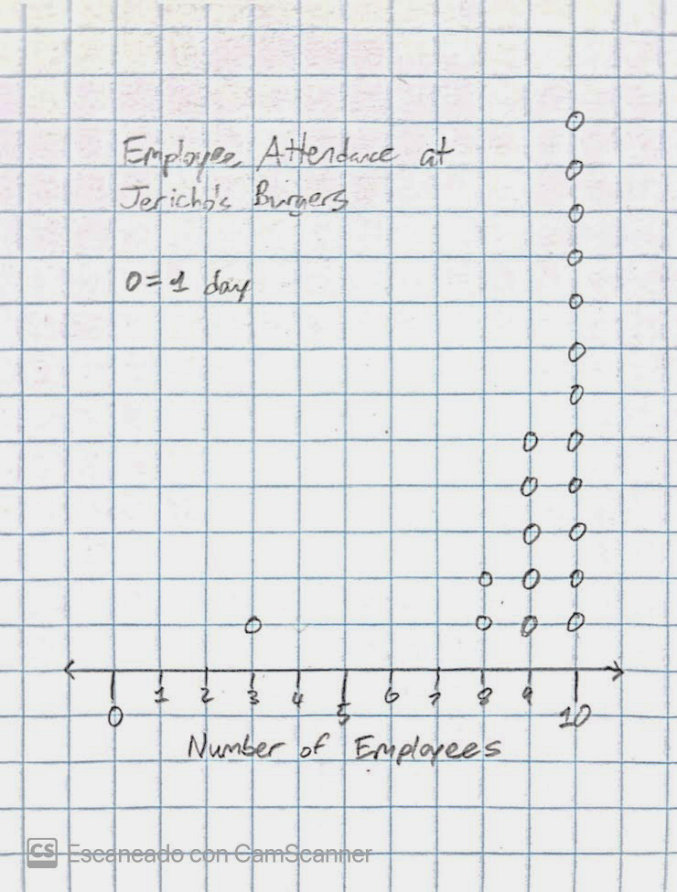
Question 13
Calculate the arithmetic mean of the data.
Acceptable answers include 9.2 employees.
interquartile range standard deviation
Notes:
Standard approximation: NY-6.SP.1
Slide designed by Benjamin Xie. Logo by Madeleine Villamil.

Slide 55
Question 14
Calculate the median of the data.
Acceptable answers include 10 employees.
interquartile range standard deviation
Notes:
Standard approximation: NY-6.SP.1
Slide designed by Benjamin Xie. Logo by Madeleine Villamil.

Slide 56
Question 15
Identify the outlier(s) in the data and provide a potential reason why they exist.
Acceptable answers include that the outlier is the one day with three employees, which could be explained by a major holiday, when most employees would be on break.
interquartile range standard deviation
Notes:
Standard approximation: NY-6.SP.1
Slide designed by Benjamin Xie. Logo by Madeleine Villamil.

Slide 57
Question 16
Identify whether the mean and/or median are affected by outliers, and justify which statistic is most appropriate if Jericho wants to find out how many employees work on a typical day.
(Acceptable answers are shown on the next slide.)
interquartile range standard deviation
Notes:
Standard approximation: NY-6.SP.1
Slide designed by Benjamin Xie. Logo by Madeleine Villamil.

Slide 58
Question 16
The mean is affected by outliers, but the median isn't. If Jericho wants to find the number of employees that will work on a typical day, he should use the median because it isn't affected by the one outlier that represents an atypical situation.
interquartile range standard deviation
Notes:
Standard approximation: NY-6.SP.1
Slide designed by Benjamin Xie. Logo by Madeleine Villamil.

Slide 59
Question 17
Calculate the mean absolute deviation of this data.
Acceptable answers include 0.96 employee.
interquartile range standard deviation
Notes:
Standard approximation: NY-6.SP.1
Slide designed by Benjamin Xie. Logo by Madeleine Villamil.

Slide 60
Question 18
Calculate the interquartile range of this data.
Acceptable answers include 1 employee.
interquartile range standard deviation
Notes:
Standard approximation: NY-6.SP.1
Slide designed by Benjamin Xie. Logo by Madeleine Villamil.

Slide 61
Question 19
Justify whether the MAD or IQR are more appropriate for this situation.
The IQR is more appropriate because, unlike the MAD, it is not strongly affected by outliers. When the median is the most appropriate measure of center, the IQR is the most appropriate measure of spread.
interquartile range standard deviation
Notes:
Standard approximation: NY-6.SP.1
Slide designed by Benjamin Xie. Logo by Madeleine Villamil.

Slide 62
Spring
6
Thanks for coming! Questions?
Kahoot for ELA
Kahoot for Statistics
Notes:
Slide designed by Benjamin Xie. Logo designed by Madeleine Villamil.

